Slide 1
Database Management
Kelly Rossa Sungkono

Slide 2

Agenda
Review Last Exercise
Aggregation Operations
Join
Class Exercise

Slide 3
Review of Data Modelling
Review Last Exercise

Slide 4
Create Table
CREATE TABLE Sailors(
sid int PRIMARY KEY NOT NULL,
sname varchar(10) NOT NULL,
rating int NOT NULL,
age decimal(4,1) NOT NULL);
CREATE TABLE Boats(
bid int PRIMARY KEY NOT NULL,
bname varchar(10) NOT NULL,
color varchar(10) NOT NULL);
CREATE TABLE Reserves(
sid int NOT NULL,
bid int NOT NULL,
day date NOT NULL);
ALTER TABLE Reserves
ADD CONSTRAINT fk_sid FOREIGN KEY (sid) REFERENCES Sailors(sid);
ALTER TABLE Reserves
ADD CONSTRAINT fk_bid FOREIGN KEY (bid) REFERENCES Boats(bid);

Slide 5
Insert Table
INSERT INTO Sailors Values
(22,'Dustin',7,45.0),
(29,'Brutus',1,33.0),
(31,'Lubbor',8,55.5),
(32,'Andy',8,25.5),
(58,'Rusty',10,35.0),
(64,'Horatio',7,35.0),
(71,'Zorba',10,16.0),
(74,'Horatio',9,35.0),
(85,'Art',3,25.5),
(95,'Bob',3,63.5);
INSERT INTO Boats Values
(101,'Interlake','blue'),
(102,'Interlake','red'),
(103,'Clipper','green'),
(104,'Marine','red');
INSERT INTO Reserves Values
(22,101,'1998-10-10'),
(22,102,'1998-10-10'),
(22,103,'1998-10-08'),
(22,104,'1998-10-07'),
(31,102,'1998-11-10'),
(31,103,'1998-11-06'),
(31,104,'1998-11-12'),
(64,101,'1998-09-05'),
(64,102,'1998-09-08'),
(74,103,'1998-09-08');

Slide 6
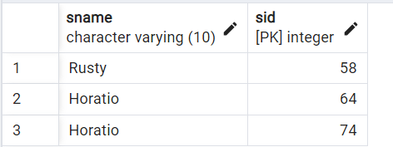
3. Select the name and sid of Sailor who has a 35 years old
SELECT sname,sid FROM Sailors
WHERE age = 35.0;

Slide 7
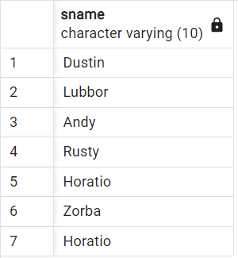
4. Select the name of Sailor who has rating more than 5
SELECT sname FROM Sailors
WHERE rating > 5;

Slide 8
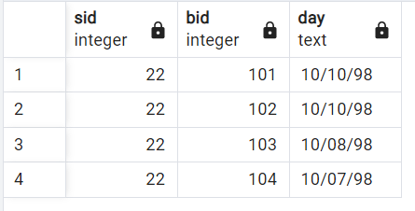
5. Select the sid, bid and day from table Reserves in October
SELECT sid,bid, to_char(day,'MM/DD/YY’) as day
FROM Reserves
WHERE extract(month from day) = 10;

Slide 9
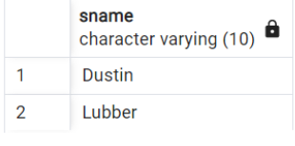
6. Select the name of Sailor who borrowed Red and Green Boats
SELECT sname
FROM Sailors
WHERE sid in (
SELECT S.sid
FROM Sailors S, Boats B, Reserves R
WHERE S.sid = R.sid and B.bid = R.bid and B.color = 'green'
INTERSECT
SELECT S.sid
FROM Sailors S, Boats B, Reserves R
WHERE S.sid = R.sid and B.bid = R.bid and B.color = 'red');

Slide 10
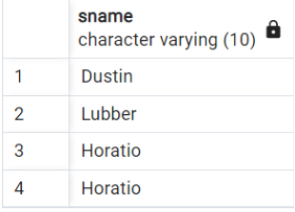
7. Select the name of Sailor who borrowed Red or Green Boats
SELECT sname
FROM Sailors
WHERE sid in (
SELECT S.sid
FROM Sailors S, Boats B, Reserves R
WHERE S.sid = R.sid and B.bid = R.bid and B.color = 'green'
UNION
SELECT S.sid
FROM Sailors S, Boats B, Reserves R
WHERE S.sid = R.sid and B.bid = R.bid and B.color = 'red');

Slide 11
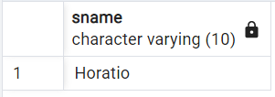
8. Select the name of Sailor who borrowed Red but not Green Boats
SELECT sname
FROM Sailors
WHERE sid in (
SELECT S.sid
FROM Sailors S, Boats B, Reserves R
WHERE S.sid = R.sid and B.bid = R.bid and B.color = 'red'
EXCEPT
SELECT S.sid
FROM Sailors S, Boats B, Reserves R
WHERE S.sid = R.sid and B.bid = R.bid and B.color = ‘green');

Slide 12
Review of Data Modelling
Aggregation Operations

Slide 13
Definition
Aggregation functions summarize the result of an expression or a number of rows, returning a single value. The commonly used aggregation syntax is as follows:
aggregate_function ([DISTINCT|ALL] expression)

Slide 14
Aggregation Function
SUM
COUNT
AVG
MIN
MAX

Slide 15
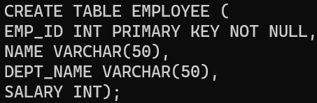
Example
Create Employee Table:
EMPLOYEE ( EMP_ID, NAME, DEPT_NAME, SALARY)

Slide 16
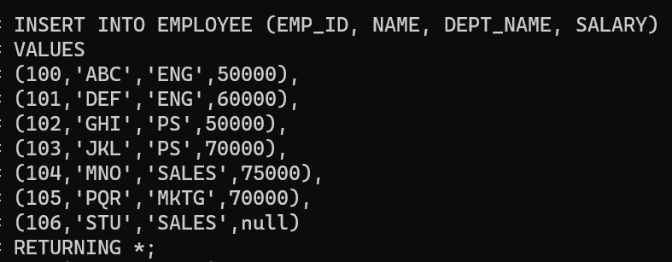
Employee Table
Insert data in Employee table

Slide 17
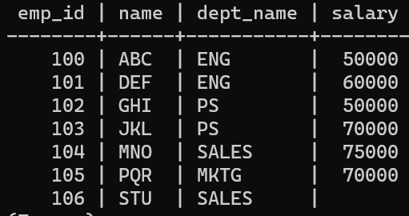
Select on Employee
SELECT FROM EMPLOYEE;

Slide 18
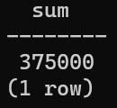
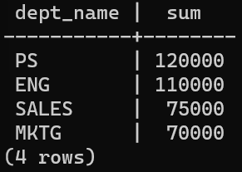
SUM
Query 1: Find the sum of all salaries
SELECT SUM(SALARY) FROM EMPLOYEE;
Query 2: Find the total salary in each department
SELECT DEPT_NAME, SUM(SALARY)
FROM EMPLOYEE GROUP BY DEPT_NAME;

Slide 19
SUM
We cannot add “where” after group by
Find total salary of ‘ENG’ Department
SELECT DEPT_NAME, SUM(SALARY)
FROM EMPLOYEE GROUP BY DEPT_NAME
WHERE DEPT_NAME = ‘ENG’;

Slide 20
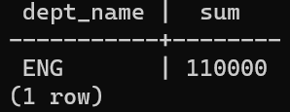
SUM
We use “having” for select using group by
Find total salary of ‘ENG’ Department
SELECT DEPT_NAME, SUM(SALARY)
FROM EMPLOYEE GROUP BY DEPT_NAME
HAVING DEPT_NAME = ‘ENG’;

Slide 21
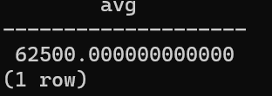

AVG
Query 1: calculate the AVG of all salaries
SELECT AVG(SALARY) FROM EMPLOYEE;
The Employee table has 7 records
and the average salary should be:
(50000+60000+50000+70000+75000+70000+null)/7 = 53571
$$?$$
Why different

Slide 22
AVG
Note: COUNT(*) is the only function that does not ignore null. Other functions like SUM, AVG, MIN, MAX ignore null.
Because in the data there are employees whose salary is null, then in the previous query:
SELECT AVG(SALARY) FROM EMPLOYEE
ignore null, so the average result is:
(50000+60000+50000+70000+75000+70000)/6
= 62500

Slide 23
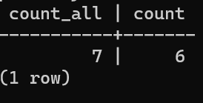
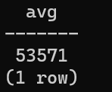
COUNT
SELECT COUNT(*),COUNT(SALARY) FROM EMPLOYEE
SELECT SUM(SALARY)/COUNT(*)
FROM EMPLOYEE
COUNT(*) = not ignore null.
COUNT(SALARY) = ignore null

Slide 24
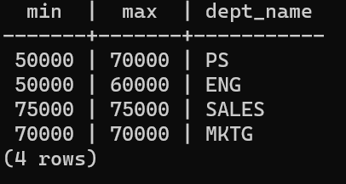
MIN MAX
Find the minimum and maximum salary of each department
SELECT MIN(SALARY),MAX(SALARY),DEPT_NAME
FROM EMPLOYEE
GROUP BY DEPT_NAME;

Slide 25
Review of Data Modelling
JOIN

Slide 26
JOIN
A join is a special form of cross product between two tables
Joins are performed by connecting tuples in one table with tuples in another table

Slide 27
Natural Join
Linking tuples in two relations that have common attributes (for example, having a foreign key that connects to other relations).
SELECT select_list
FROM table1
NATURAL [INNER, LEFT, RIGHT, FULL]
JOIN table2

Slide 28
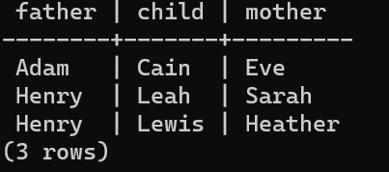
Natural Join
Paternity
Maternity
Paternity ⋈Maternity
Father | Child
Adam | Cain
Adam | Abel
Henry | Leah
Henry | Lewis
Mother | Child
Eve | Cain
Eve | Seth
Sarah | Leah
Heather | Lewis
Father | Child | Mother
Adam | Cain | Eve
Henry | Leah | Sarah
Henry | Lewis | Heather
SELECT P.Father, P.Child, M.Mother
FROM Paternity P
NATURAL JOIN Maternity M

Slide 29



Outer Join
A join that can return a value even if the side of the related table is NULL
Outer Join:
Left outer join, notation:
Right outer join, notation:
Full outer join, notation:

Slide 30
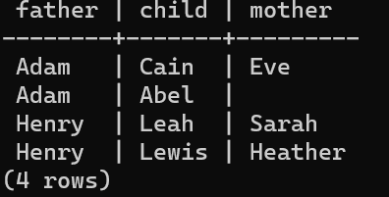
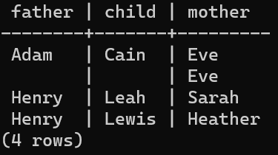
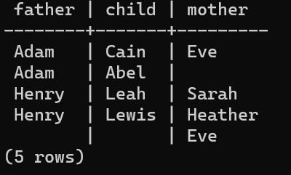
Example: Outer Join
SELECT P.Father, P.Child, M.Mother
FROM Paternity P
NATURAL LEFT JOIN Maternity M
SELECT P.Father, P.Child, M.Mother
FROM Paternity P
NATURAL RIGHT JOIN Maternity M
SELECT P.Father, P.Child, M.Mother
FROM Paternity P
NATURAL FULL JOIN Maternity M
Paternity (P)
Maternity (M)
Father | Child
Adam | Cain
Adam | Abel
Henry | Leah
Henry | Lewis
Mother | Child
Eve | Cain
Eve | Seth
Sarah | Leah
Heather | Lewis
P M
P M
P M

Slide 31
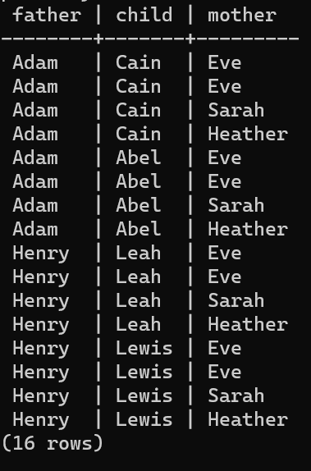
Cross Join
Cross join is used to produce Cartesian product between two tables
SELECT P.Father, P.Child, M.Mother
FROM Paternity P
CROSS JOIN Maternity M

Slide 32
Review of Data Modelling
Exercise

Slide 33
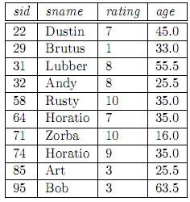
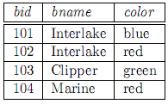
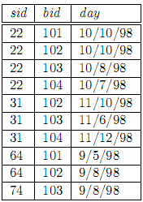
Class Assignment
Database ‘Boat Rental’ Scheme:
Sailors(sid: integer, sname: varchar(10), rating: integer, age: decimal(4,1))
Boats(bid: integer, bname: varchar(10), color: varchar(10))
Reserves(sid: integer, bid: integer, day: date). The format of day is Month/Day/Year

Slide 34
Class Assignment
Select the sid and name of sailor that has a rating greater than the rating average
Select the sid and name of sailor that has the most number of reservations
Select the average age of sailors reserving ‘Interlake’ or ‘Marine’ boats
Select the month and the number of reservations for each month
Select the percentage of red boat reservations of all reservations

Slide 35
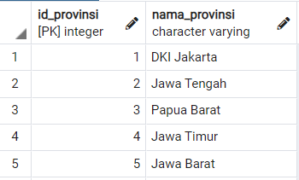
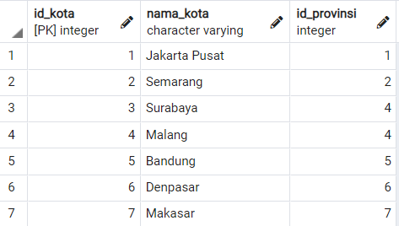
Class Exercise
No need to define FK in ‘Kota’ table

Slide 36
Assignment
Select a number of city of “Jawa Timur”
Select the name of province that has maximum number of city
Select all province’s name and the number of their cities
Select name of provinces and name of cities of those provinces (if the province didn’t have city, the column ‘nama_kota’ will be null)
Select name of provinces that don't have a city

